Slide 1
College of Engineering,
Electrical Engineering Department
Class : Second Year
Subject : Digital Techniques
Comparator
By:
Asst Lec. Besma Nazar Nadhem
Master of Science in Electrical Engineering
(Electronic and Communication)

Slide 2
Magnitude Comparator
A magnitude comparator is a combinational circuit that compares two given numbers and determines whether one is equal to, less than or greater than the other.
The output is in the form of three binary variables representing the conditions A = B , A>B and A<B, if A and B are the two numbers being compared
The function of each gate can be represented by a truth table or using Boolean notation

Slide 3
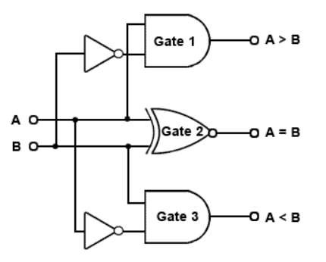
For two binary numbers , each one have one bit , the truth table :
Z1 Z2 Z3
A B A>B A=B A<B
0 0 0 1 0
0 1 0 0 1
0 1 0 0
1 1 0 1 0
Z1(A>B) = AB
Z2(A=B)=A⊙B
Z3(A<B)=AB
A < B
A
Magnitude
Compare
A = B
B
A > B

Slide 4
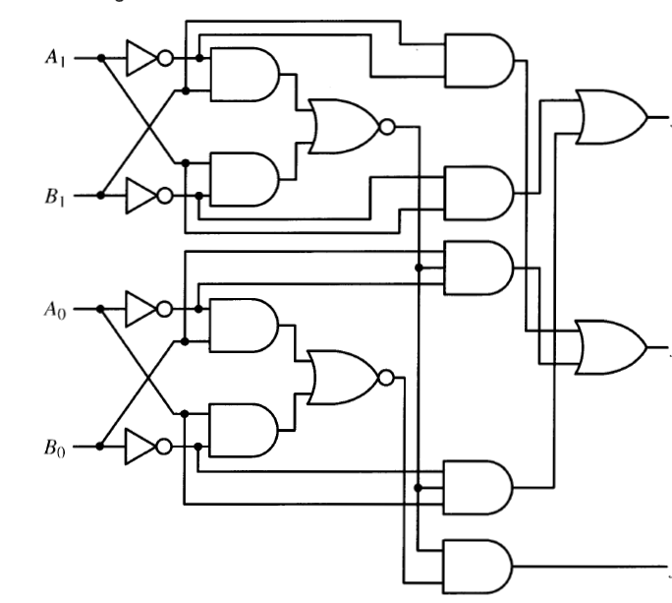
For two binary numbers , each one have two bits (n=2)
A=A1A0
B=B1B0
A>B=(A1>B1)OR(A1=B1)AND(A0>B0)
A>B=A1B1+(A1⊙B1)(AoBo)
A<B=(A1<B1)OR(A1=B1)AND(A0<B0)
A<B=A1B1+(A1⊙B1)(AoBo)
A=B=(A1=B1)AND(A0=B0)
A=B=(A1⊙B1)(Ao⊙Bo)
A > B
A < B
A =B

Slide 5
7485 IC
Two binary numbers 4 bits comparator
Ao
7485 IC
A1
A2
A3
>
0
=
1
0
<
Bo
B1
B2
B3

Slide 6
Example : Use 7485 IC to compare two binary numbers each one have eight bits
A=A7A6A5A4A3A2A1A0
B=B7B6B5B4B3B2B1B0
Ao
7485 IC
A4
7485 IC
A1
A5
A2
A6
A3
A7
>
>
G
0
>
=
>
=
E
1
=
=
0
<
<
<
L
<
Bo
B4
B1
B5
B2
B6
B3
B7

Slide 7
Example : Design H.A using Comparator only :
Solution :
S=AB+AB=A⊕B
Co= AB
>
A1
A
=
A⊙1
S=A⊕B
1
B
<
A1 =A
Co=AB

